Slide 1

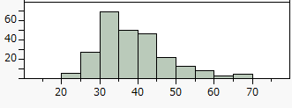
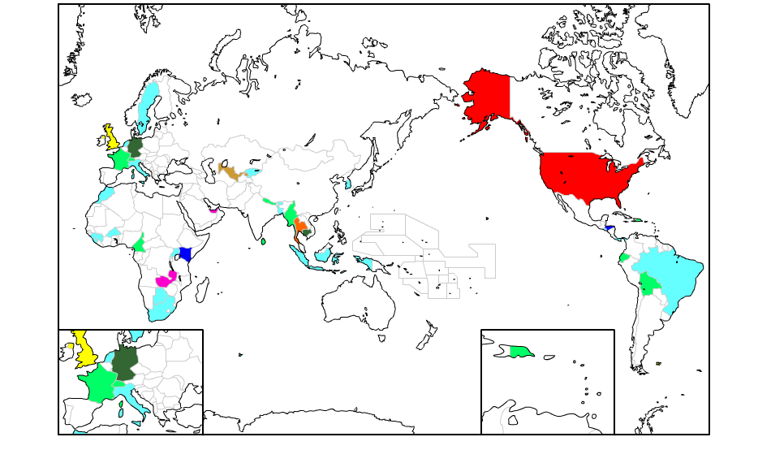
The Mental Health Research for Japanese who are living in outside Japan
Takeshi YODA¹⁾, Katsunori YOKOYAMA^{1),2)}, Marie YORIKI^{1),2)}, Akira YOSHIOKA³⁾,
Hiromi SUZUKI¹⁾, Tomohiro HIRAO¹⁾
Department of Public Health, Faculty of Medicine, Kagawa University
Graduate school of Medicine, Kagawa University
Sports Education Center, Okayama University
Introduction
It is officially reported that approximately 1.2 million Japanese are living in outside Japan. Generally speaking, foreign residents tend to have many stresses and sometimes they have mental disorders. We used self-administered questionnaires for an internet survey to investigate mental health condition for Japanese residents in overseas countries.
Methods
We collected data using internet survey. We introduced our mental research for overseas Japanese residents through Japan clubs in some countries and mailing lists for overseas Japanese residents from July 2013 to January 2014. We made self-administrated questionnaire for an internet survey to know the socio-economic status, living place and period, domicile country’s language skills. For evaluate the mental health, we used Insomnia score (IS) from Hamilton Rating Scale for Depression and K6 score for the evaluation of the depression. We defined IS more than 3 as serious insomnia and K6 more than 5 as possible depression from former studies.
Results
Total 241 workers from 37 countries were answered, of which mean age was 37.9 (± 8.7) years old and male residents were 85(35.7%). Most residents (108, 45.0%) were living in USA. IS more than 3 was 16 (6.6%) people and K6 more than 5 was 68 (29.6%) people respectively. The characteristics for serious insomnia and possible depression are shown in Table 1.
Table 1. Characteristics about Serious insomnia and possible Depression
Age distribution
 |  | Insomnia Score |  |  | K6 Score
 |  | Serious insomnia | No insomnia | p✝ | Possible depression | No depression | p✝
Gender | Male | 6 | 79 | 0.87 | 20 | 59 | 0.26
 | Female | 10 | 143 |  | 48 | 100
Age (Mean) |  | 37.7 | 40.0 | 0.32 | 36.1 | 38.3 | 0.06
Educational attainment | ≤High school | 4 | 45 | 0.26 | 14 | 31 | 0.91
 | University | 6 | 126 |  | 39 | 90
 | Graduate school+ | 6 | 49 |  | 14 | 37
Marital Status | Married | 6 | 129 | 0.17 | 41 | 57 | <0.01*
 | Not Married | 9 | 94
 |  |  |  |  | 27 | 103
Chronic diseases | None | 5 | 50 | 0.32 | 47 | 128 | 0.07
 | ≥1 | 10 | 174 |  | 21 | 32
Smoking Status | Non-smoker | 9 | 192 | <0.01* | 15 | 139 | 0.08
 | Smoker | 6 | 30 |  | 52 | 21
Drinking Status | Never | 5 | 75 | 0.98 | 45 | 103 | 0.79
 | Sometimes/ Everyday | 10 | 148 |  | 23 | 57
Inmate number | 1 | 6 | 82 | 0.83 | 26 | 60 | 0.72
 | 2 | 4 | 44 |  | 12 | 35
 | 3 | 2 | 39 |  | 9 | 30
 |  |  |  |  | 12 | 21
 | 4 | 2 | 33
 | ≥5 | 0 | 13 |  | 3 | 10
Country status | Developed | 4 | 123 | 0.02* | 37 | 82 | 0.63
 |  |  |  |  | 31 | 79
 | Developing | 12 | 101
living place language skill‡ (total score; Mean) |  | 7.87 | 7.75 | 0.91 | 8.48 | 7.53 | 0.13
(N)
Living place distribution
(Years old)
USA (108), Thailand (48), Zambia, UAE (10), UK (8),
Uzbekistan (6), Germany, Cambodia (4), Honduras, Kenya (3),
9 countries(2), 18 countries (1)
The number in parentheses are shown as answered people’s number
✝Pearson’s chi-square test or t-test *: p<0.05
‡ Living place language skill is a total score for the results of self-evaluation about reading, writing, and conversation scoring from poor=1, to good=5; full marks are 15 point
Discussion
There are significant differences of smoking status and country status for serious insomnia. And there is also correlation with possible depression and marital status. Although the sample size is small, our research results suggest that relatively high number of people may suffer from mental illness compare with original Japanese residents. To confirm our results, we will proceed to further research in the near future.
Acknowledgement
The authors would like to thank Marika Nomura, PhD of Harvard school of public health, Asako Miyashita of Nihon Medical Healthcare and Takuma Kato MD of Mahidol University for assistance with experiments. This study was supported by JSPS KAKENHI（Grant Number 24790620）.

